Slide 1
Lesson 7: aligning in bAse
Seshan brothers

Slide 2
WHY Align in base
Aligning in base helps your robot get a good start
When you begin your run, consider backing into the wall to straighten out before you head out of base

Slide 3
LINES AND MARKINGS IN BASE
Notice that base has markings like a grid. Use these to align
You can also use the text in base to align your robot (eg. at the top of the word FIRST)

Slide 4
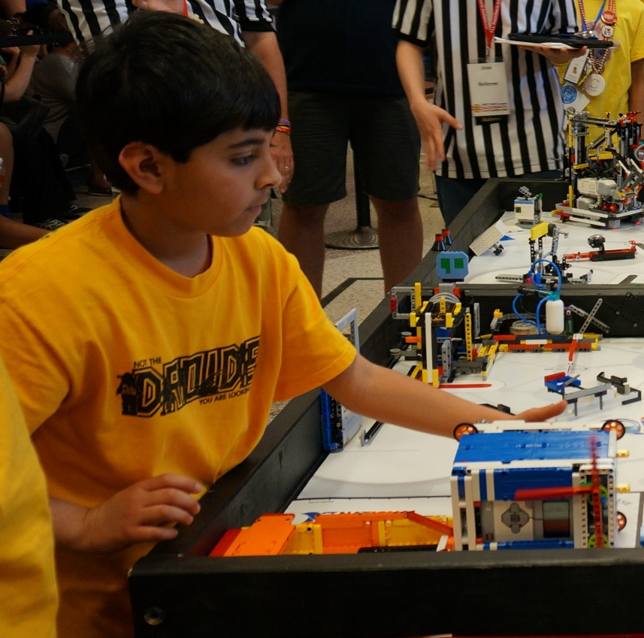
JIGS
Jigs are LEGO guides/rulers that the team places in base
The robot is pushed against the jig for alignment
Jigs can be made from any LEGO elements (including Duplo)

Slide 5

Credits
This tutorial was created by Sanjay Seshan and Arvind Seshan
More lessons at www.ev3lessons.com and www.flltutorials.com
This work is licensed under a Creative Commons Attribution-NonCommercial-ShareAlike 4.0 International License.

